Slide 1



Reinforecement Learning USE TesT case (FOR discussion)
Dec 2021
YeongJu

Slide 2
Analytics outcome Deployment
Deployment Type | Use Case | Challenge
Quick actions from analytic insight | RC Fan replacement Ball box more frequent replacement | Requires investments (SOP change, sensor installment, machine replacement)
Dashboard / Webapp for informed decisions | Recycle material mix optimization CM – bending and tilting models | Extra efforts to make UI UI maintenance Operators don’t need to follow
Machine Control for optimization | Predictive zone 3 control Air/gas ratio automation (today’s presentation) | Interaction with PLC real time data Working with automation

Slide 3
CONTENTS
Supervised vs. Reinforcement Learning
RL - Model based vs. Model Free
Perceptron Using Pytorch
Cartpole Problem
Use Test Case – Air/Gas Ratio Automation

Slide 4
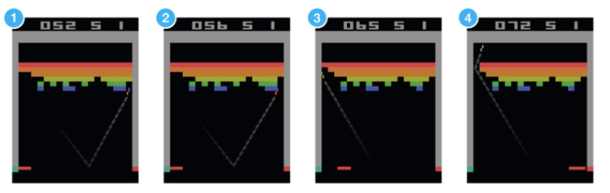
Supervised Learning vs. Reinforcement learning
Reinforcement learning makes sequential decisions to maximize total rewards to come.

Slide 5
Model based vs. Model Free
Sequential Decision Making
Markov Decision Process (MDP)
Know transitions
Don’t know transitions
Model Based
Model Free
Solution from iterations
Solution from sampling
Planning
Reinforcement Learning
Dynamic
programming
Monte
Carlo
Tree Search
Time-Difference
Learning
(e.g) Chiraq’s inventory solution
DQN (Deep Q Network)

Slide 6

Pytorch

Slide 7
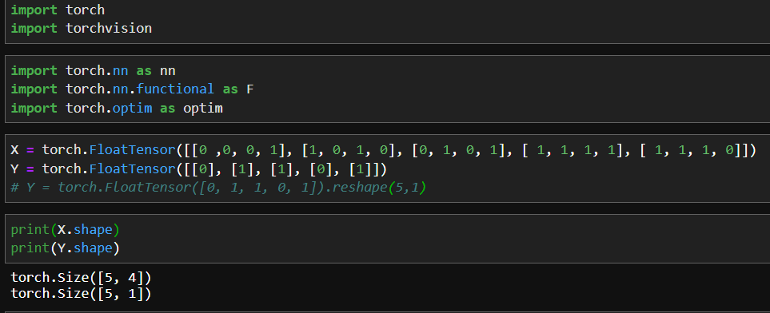
Pytorch Coded Perceptron (1/2)
Y
Matrix (5,1)
Y = F(x1, x2, x3, x4)
Matrix (2,1)
Matrix (4,2)
Neural Network
Matrix (5,4)
X1
X2
X3
X4

Slide 8
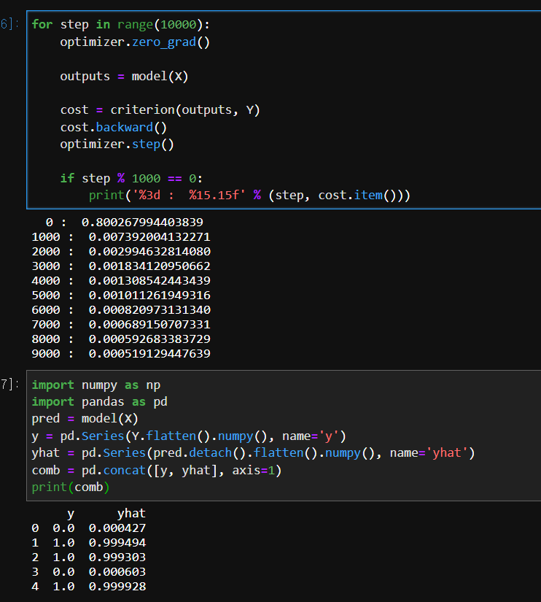
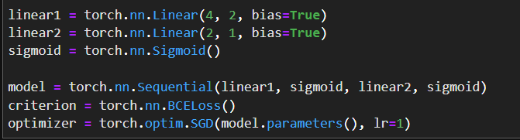
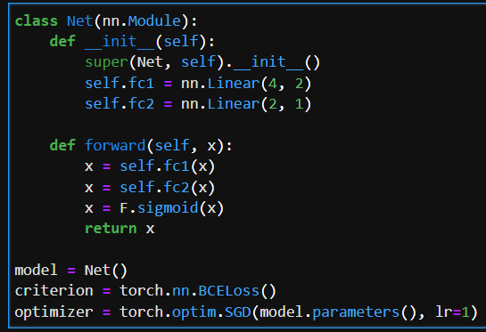
Pytorch Coded Perceptron (2/2)
Gradient Descent Optimization
Matrix (2,1)
Matrix (4,2)
Stacking
Backpropagation
Update weights
Functional

Slide 9
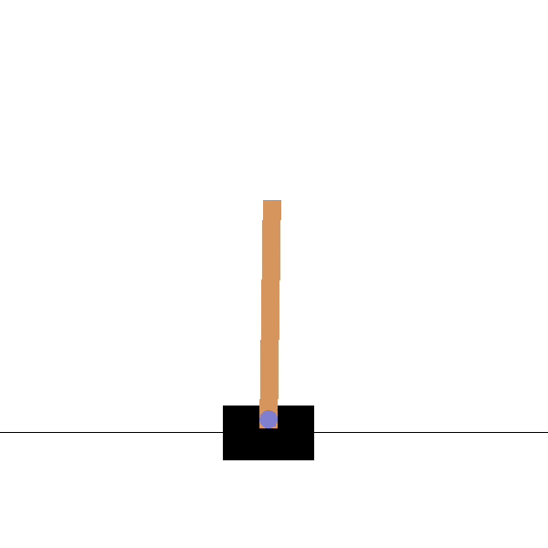
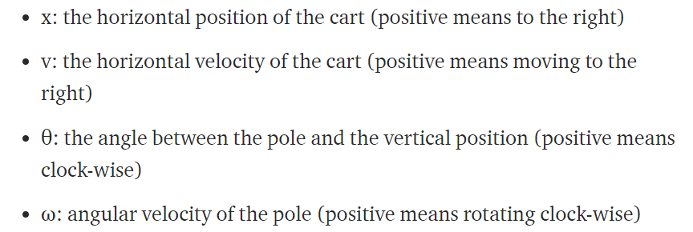
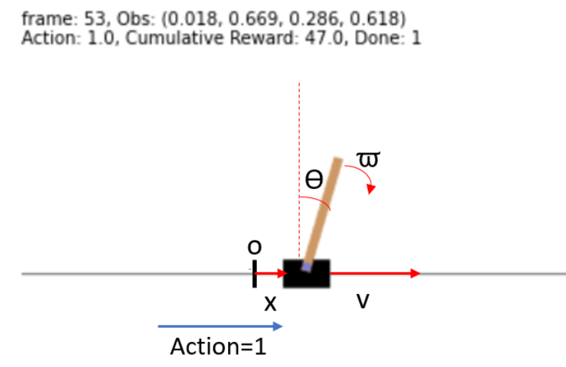
Cartpole Problem
https://youtu.be/XiigTGKZfks
4 states to represent the current observation:
Observe the current states and Find the optimal actions (Left or Right) to keep the pole upright straight.
1 Reward is given if the pole stands upright. (less than 15 degrees)
Trial fails if the pole is more than 15 degrees from vertical
Trial succeeds if movement ticks are more than 500 times

Slide 10
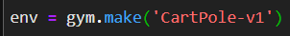
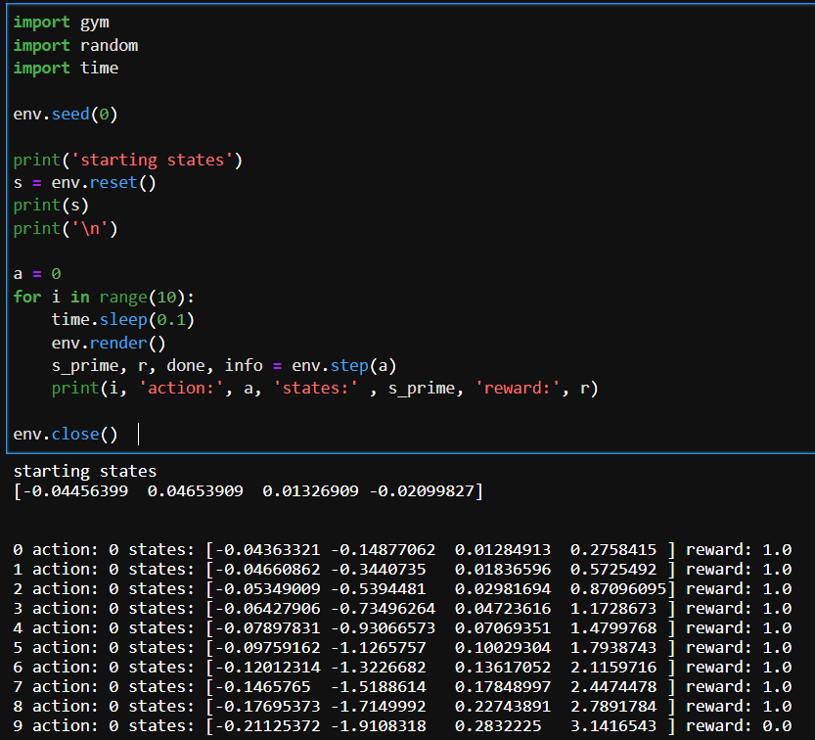
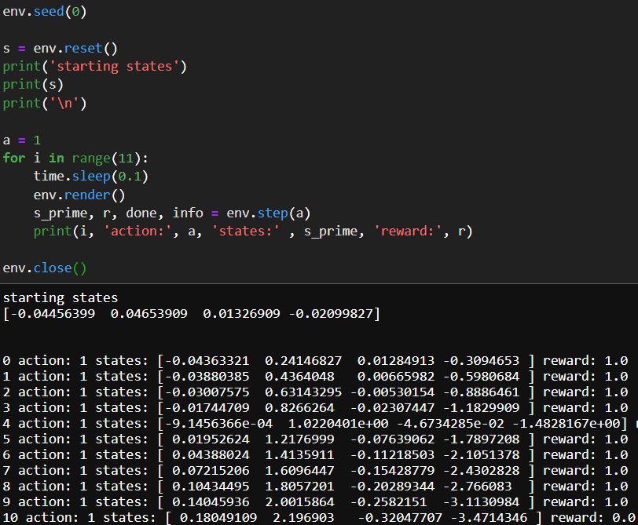
Open-AI Cartpole Environment
Keep pushing to left side
Keep pushing to right side

Slide 11
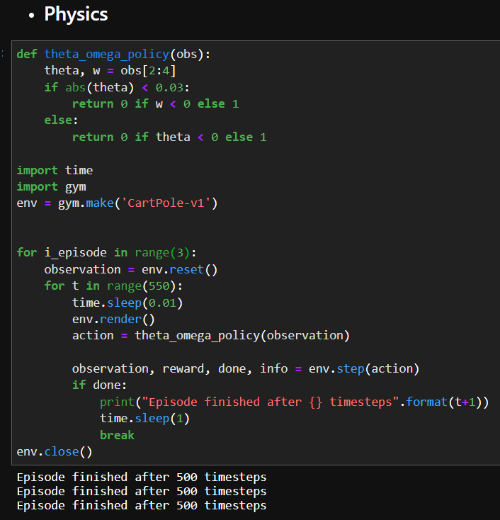
Open-AI Cartpole Environment (Physics)

Slide 12
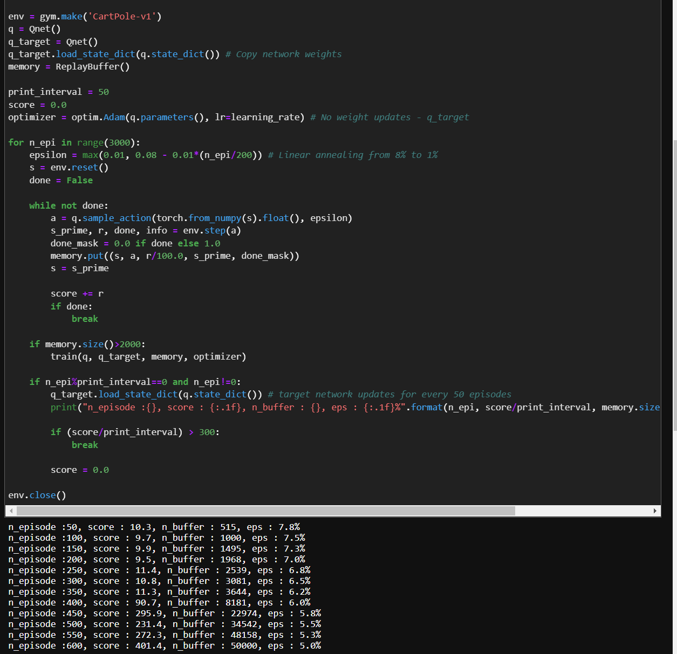
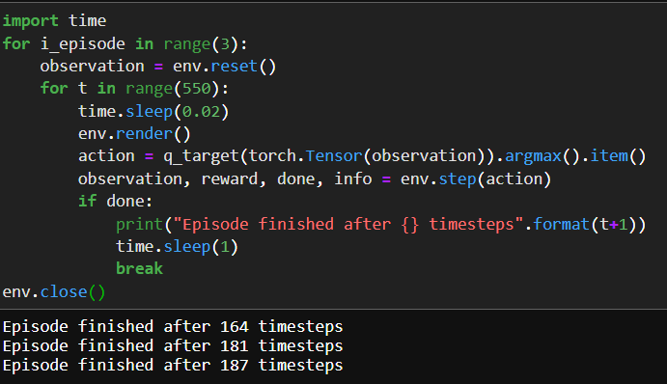
Open-AI Cartpole Environment (DQN)
Learning Policy Using DQN

Slide 13
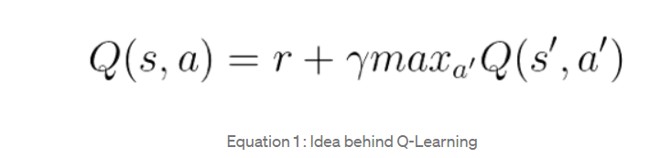
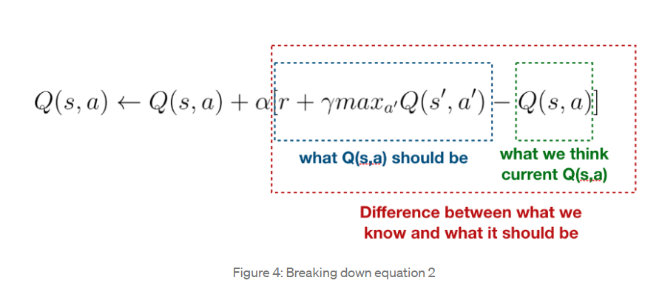
Deep q Network
Basic Algorithm:
“We want to minimize the loss so that there is nothing to learn!”
Blue Box – Perfect Q function
Green Box – Current Q function
Red Box - loss function of DQN.
https://towardsdatascience.com/reinforcement-learning-concept-on-cart-pole-with-dqn-799105ca670

Slide 14
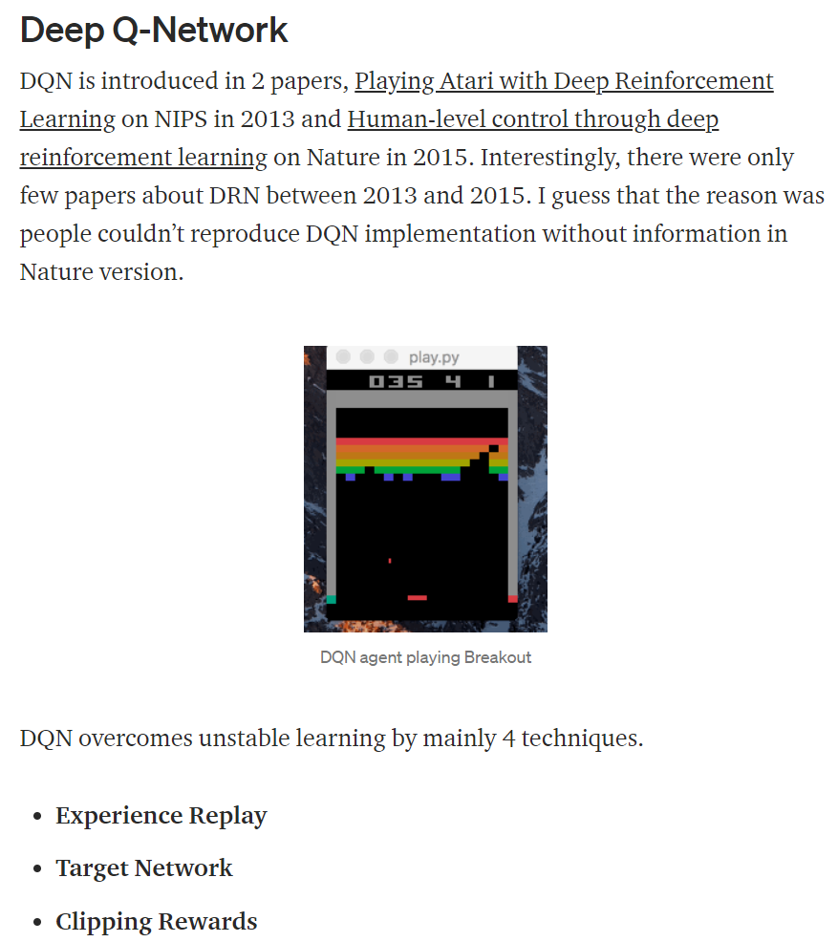
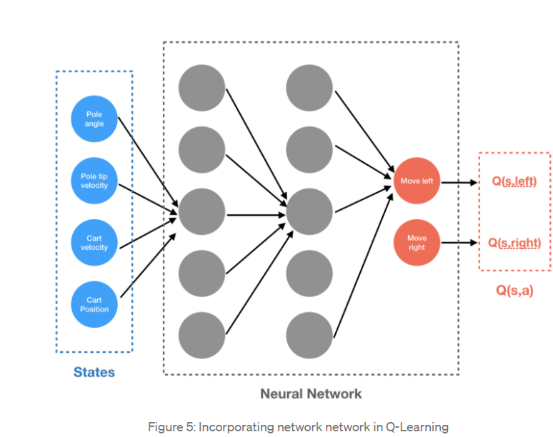
Deep q Network
Network We Need
https://towardsdatascience.com/reinforcement-learning-concept-on-cart-pole-with-dqn-799105ca670
https://towardsdatascience.com/welcome-to-deep-reinforcement-learning-part-1-dqn-c3cab4d41b6b

Slide 15
Deep Q Network
Things We Need to Know before Applying DQN:
X1
X2
X3
X4
Observation States Space : [X1, X2, X3 X4]
Action Space: [0, 1]
Reward Structure: 1 if theta(X3) is less than 15 degree 0 otherwise -> Game Over!
Transition:
Env.Reset() Initiate a simulation by creating starting states
Env.Step( action ) Generate ‘next states’, ‘reward’, ‘end flag’ given an action

Slide 16
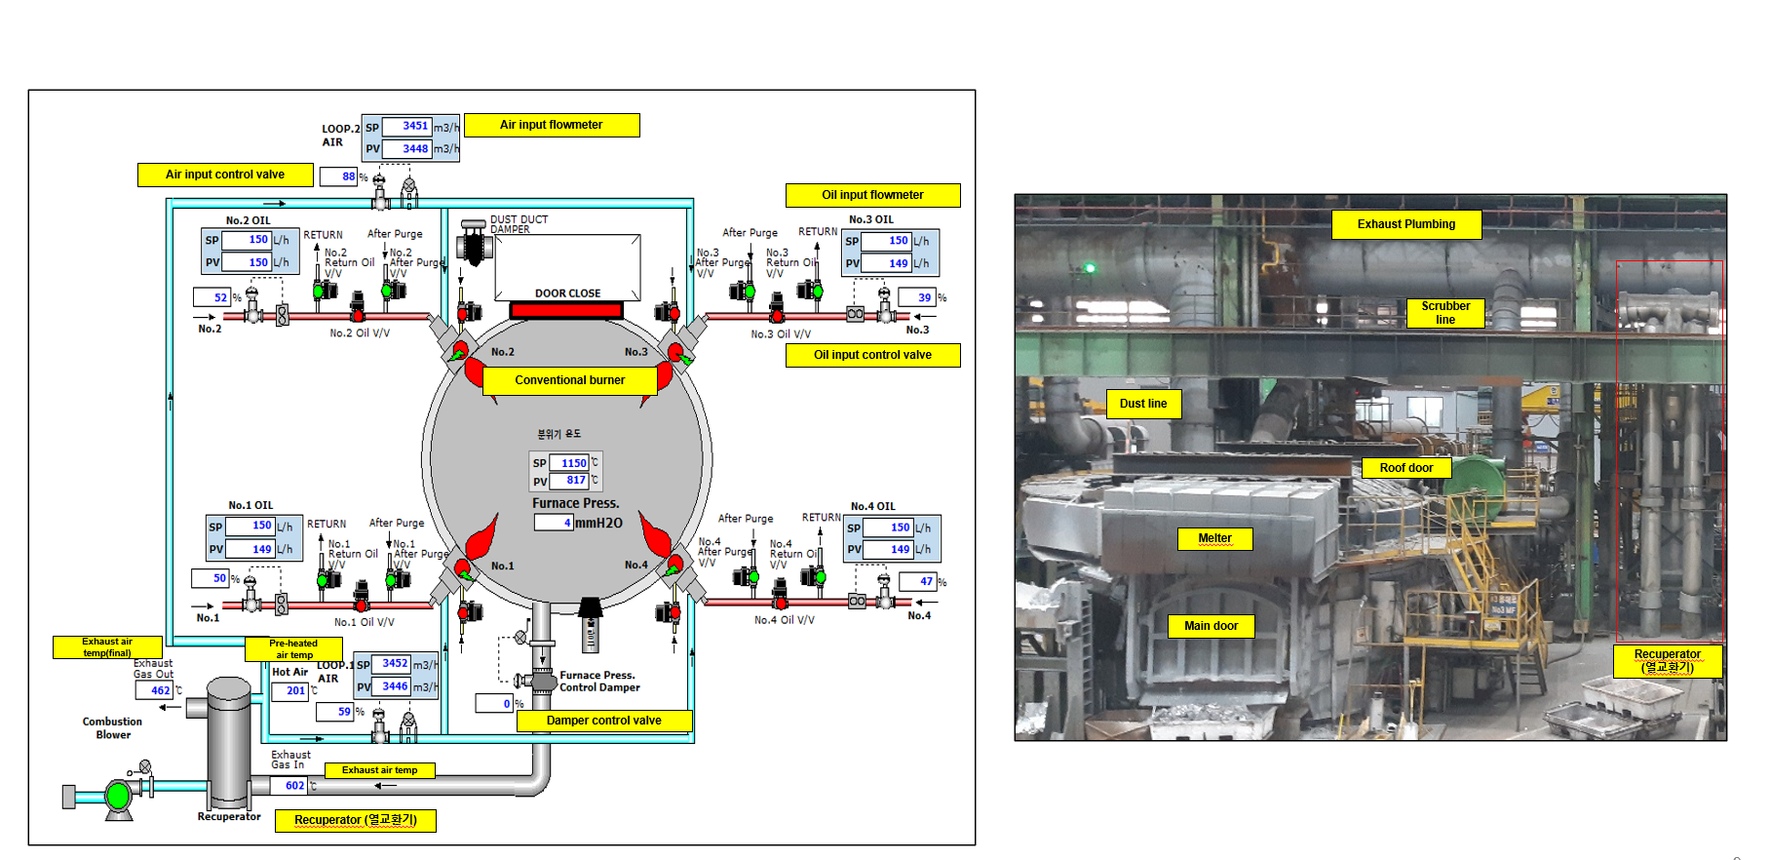
Air-Gas Ratio
REMELT MELTER
High air to gas ratio: Too much air and less fuel generates weak heat.
Low air to gas ratio: Too much fuel and less air makes the fuel wasted, because fuel are not turned into heat 100%.

Slide 17
Air-Gas Ratio
Why Do We Use RL for ‘Air-Gas Ratio’ Problem?
If we were to know the optimal air-gas ratio given situation, then we would be better off doing supervised learning such that Action = F(States)
We simply don’t know the optimal air-gas ratio given states. (Physics engineer probably knows…)
As such, we want to test RL to know if it is working.
For RL to work, we set up a performance reward at the end of cycle.

Slide 18
Air-Gas Ratio
We must define:
X1: Preheater Temperature
X2: Melter Inner Pressure
X3: Melter Inner Temperature
X4: Cold(Non-Molten) Input (Ton)
Observation States Space : [X1, X2, X3, X4]
Action Space: [0, 1, 2, 3, 4]
Reward Structure: When the temperature reaches 960, Reward = (1) + (2) (1) Average temp increase / min is greater than 5 degree (speedy temp increase) (2) Average Air/gas ratio (fuel saving)
Transition:
Env.Reset() Initiate a simulation by randomly selecting starting states
Env.Step( action ) Generate ‘next states’, ‘reward’, ‘end flag’ given an action

Slide 19
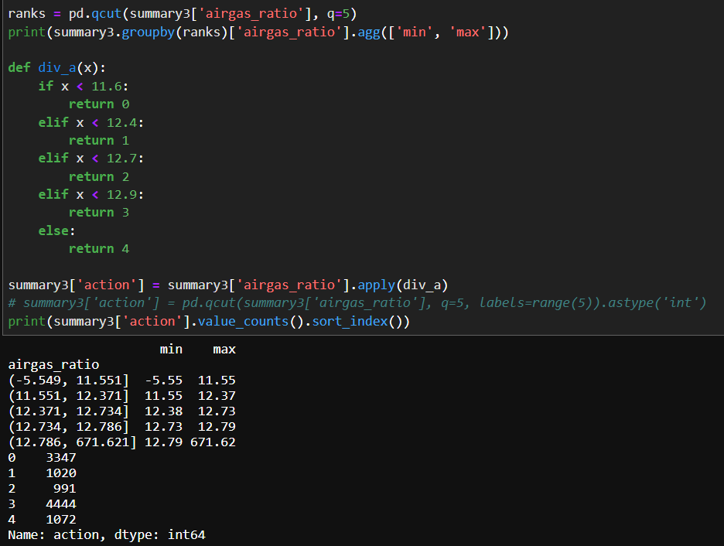
Air-Gas Ratio
Action Space: 5 actions

Slide 20
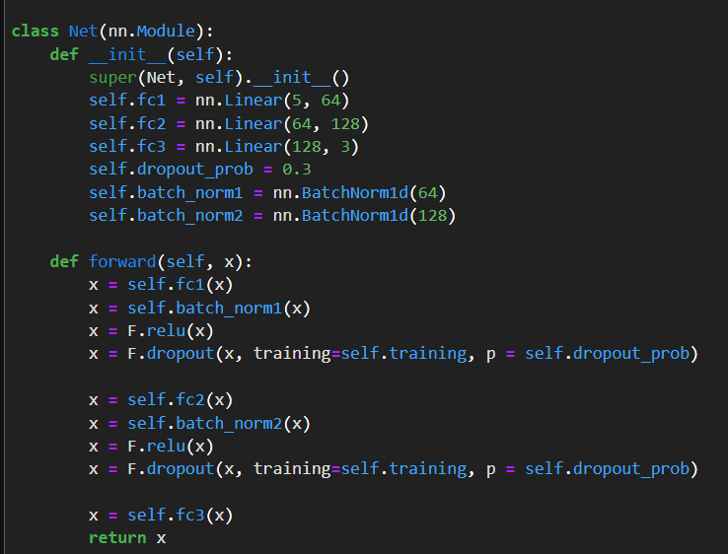
Air-Gas Ratio
3 minutes later
X1: Preheater Temperature
X2: Melter Inner Pressure
X3: Melter Inner Temperature
X4: Cold(Non-Molten) Input (Ton)
Transition Function:
F(X1, X2, X3, X4, Action) = Delta (X1, X2, X3)

Slide 21
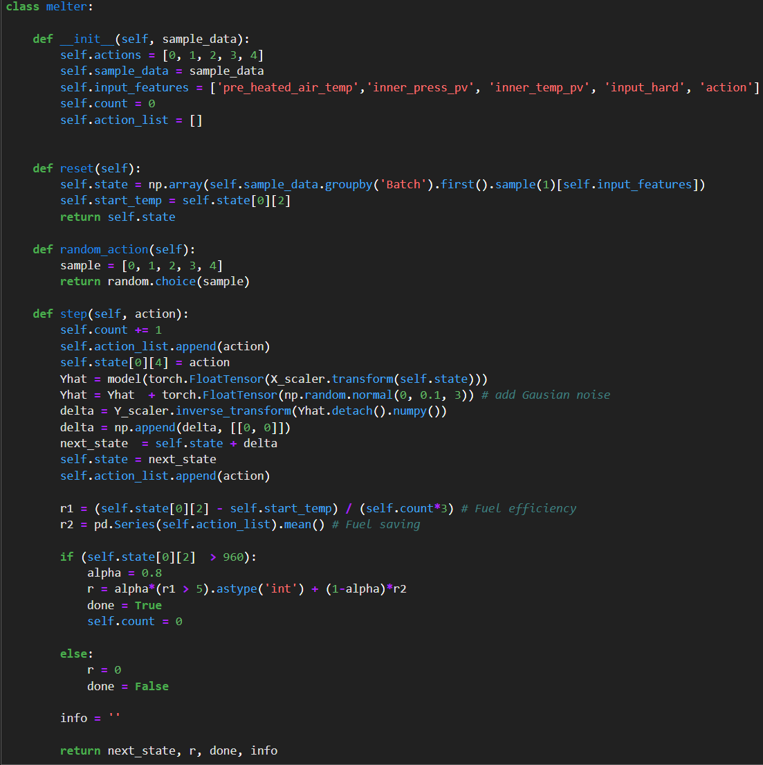
Air-Gas Ratio
Melter(Furnace) Environment:
Env.Reset() Initiate a simulation by randomly selecting starting states
Env.Step( Action ) - Generate ‘next states’, ‘reward’, ‘end flag’ given an action - Gaussian noise added to the next states
Random_Action()
Random action from an action space
Transition to next states with random noise
Reward is given
when the temperature
reaches above 960

Slide 22
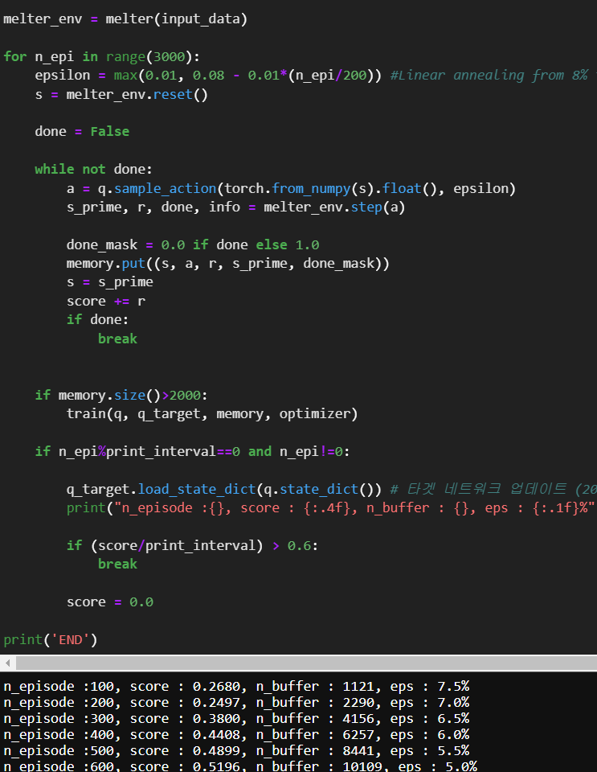
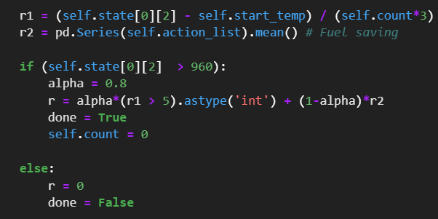
Air-Gas Ratio: Reinforcement Learning
DQN Learning
Reuse Cartpole scripts with a few parameter tunning
3,000 simulations
Reward structure

Slide 23
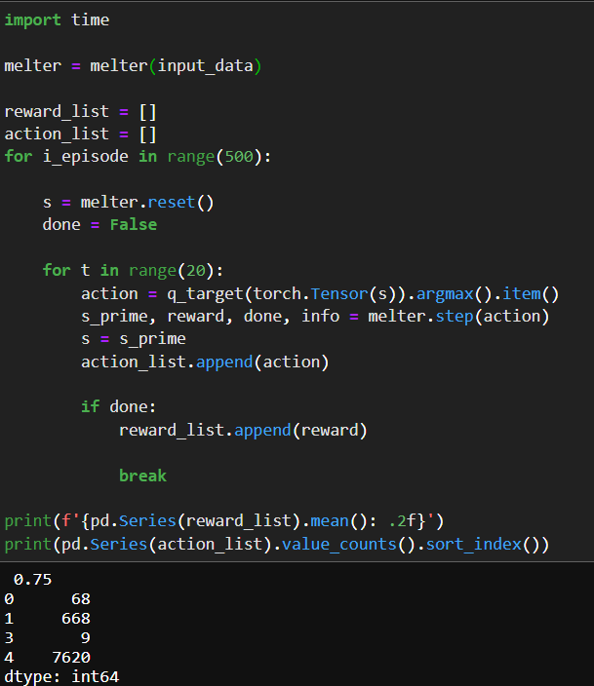
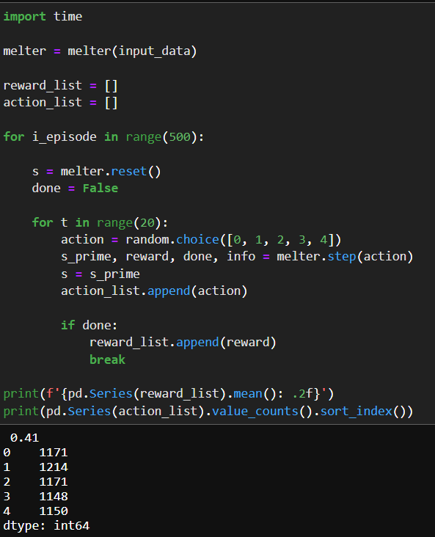
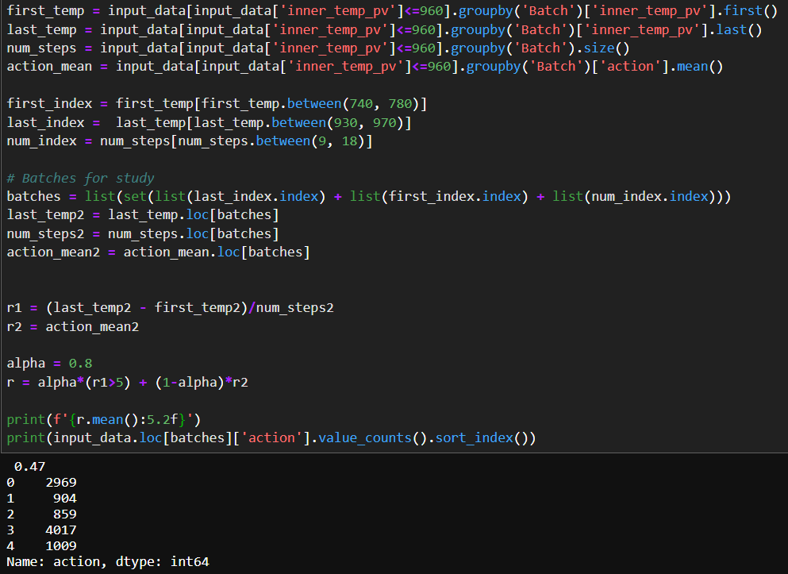
Air-Gas Ratio
Performance
RL - Learned Actions (Simulation)
Random Actions (Simulation)
Actual Actions (Real Data)
Avg Reward = 0.75
Avg Reward = 0.41
Avg Reward = 0.47

Slide 24
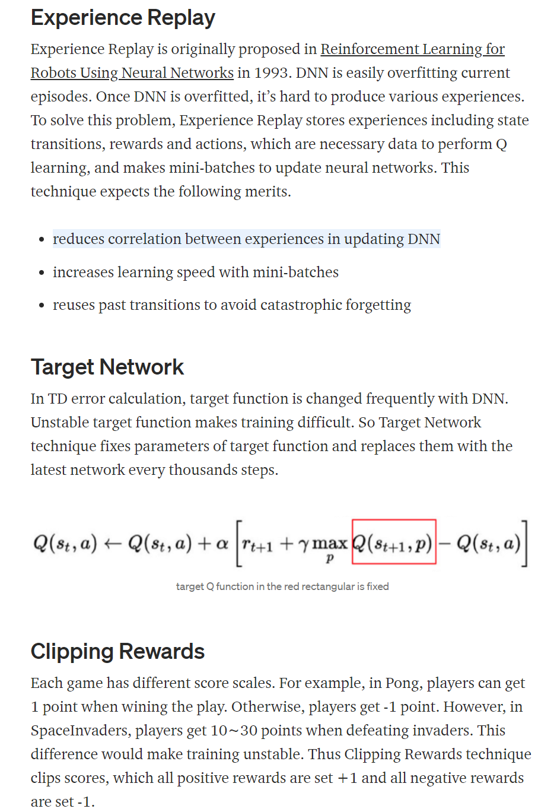
Appendix
https://towardsdatascience.com/welcome-to-deep-reinforcement-learning-part-1-dqn-c3cab4d41b6b

